Slide 1
6 Application Protocols for IoT
Yuemin Ding
Tecnun School of Engineering
University of Navarra

Slide 2
Outlines
Transport Layer Protocols
Application layer protocol not present
Supervisory control and data acquisition (SCADA)
IoT application layer protocols
Constrained Application Protocol (CoAP)
Message Queuing Telemetry Transport (MQTT)

Slide 3
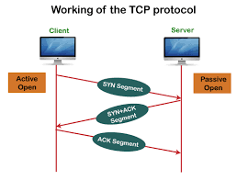
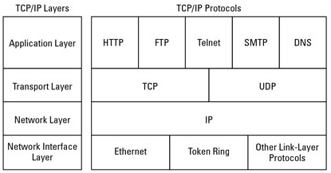
Transport Layer-TCP
Transmission Control Protocol (TCP) → connection-oriented protocol
TCP requires a session to get established between the source and destination before exchanging
TCP ensures reassembly in a correct sequence, flow control and window adjustment, and retransmission of lost packets.

Slide 4
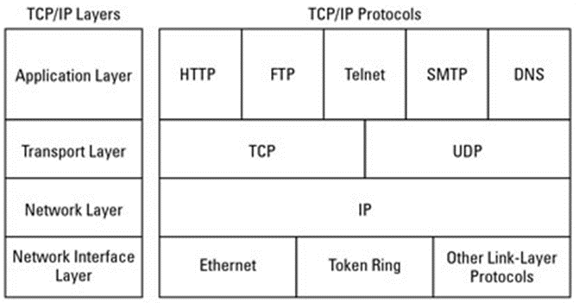
Transport Layer
User Datagram Protocol (UDP)→connectionless protocol
Data can be quickly sent between source and destination, but with no guarantee of delivery.
While TCP can be challenging on constrained IoT devices and networks, UDP is more used in LLNs sending few bytes of data.

Slide 5
Outlines
Transport Layer Protocols
Application layer protocol not present
Supervisory control and data acquisition (SCADA)
IoT application layer protocols
Constrained Application Protocol (CoAP)
Message Queuing Telemetry Transport (MQTT)

Slide 6
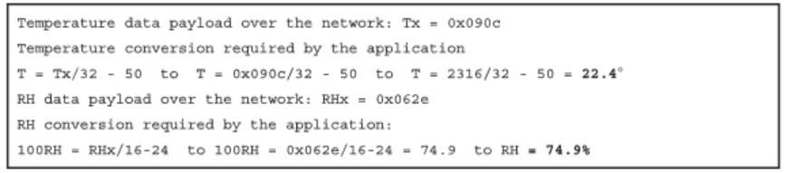
No Application Layer Protocol
Class 0 devices are usually simple and severely constrained.
They do not implement a fully structured network protocol stack, such as IP, TCP, or UDP, or even an application layer protocol.
E.g., a low-cost temperature (2 bytes) and relative humidity sensor (2 bytes) may directly send the data through MAC Layer

Slide 7
No Application Layer Protocol
For Class 0 devices, the lack of fully structured protocol and standardization makes it difficult for interoperability purposes.
Imagine different kinds of temperature sensors from different manufacturers are used, the sensors will report temperature data in varying formats.

Slide 8
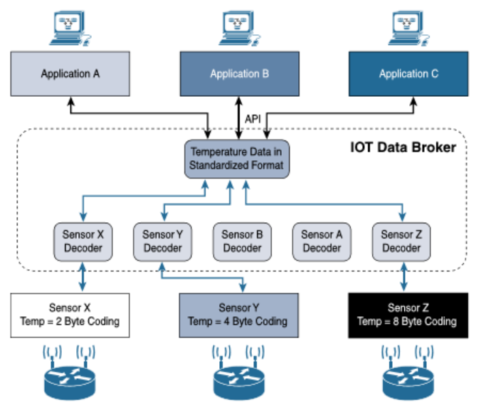
No Application Layer Protocol
If this is your scenario, the solution is to use an IoT data broker

Slide 9
Outlines
Transport Layer Protocols
Application layer protocol not present
Supervisory control and data acquisition (SCADA)
IoT application layer protocols
Constrained Application Protocol (CoAP)
Message Queuing Telemetry Transport (MQTT)

Slide 10
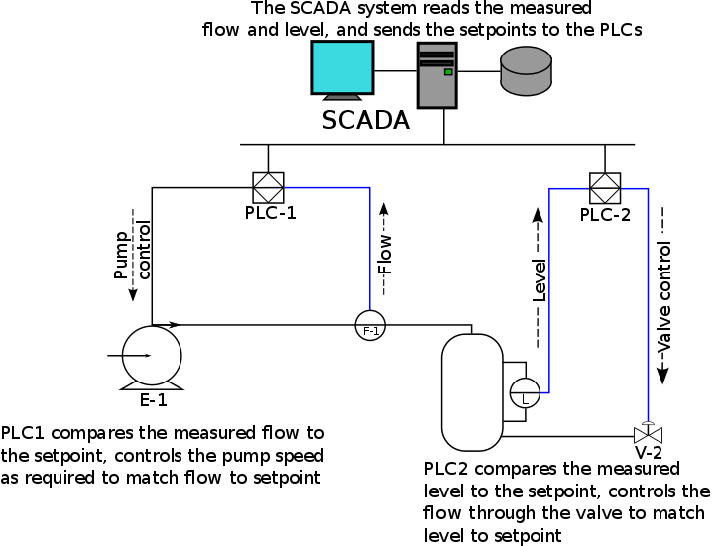
Introduction to SCADA
SCADA refers to automation control systems that was initially implemented without IP.
Many of them were defined and implemented decades ago based on serial links, such as RS-232 and RS-485.
SCADA systems allow global, real-time, data-driven decisions to be made about how to improve business processes
Source: wikipedia.org

Slide 11
Adapting SCADA for IP
The rapid adoption of Ethernet networks in the industrial world drove the evolution of SCADA application layer protocols. E.g.:
DNP3 (Distributed Network Protocol version 3) specifies the use of TCP or UDP on port 20000 for transporting DNP3 messages over IP.
The Modbus messaging service utilizes TCP port 502.
…
Benefits of moving to Ethernet and IP include the ability to leverage existing equipment and standards

Slide 12
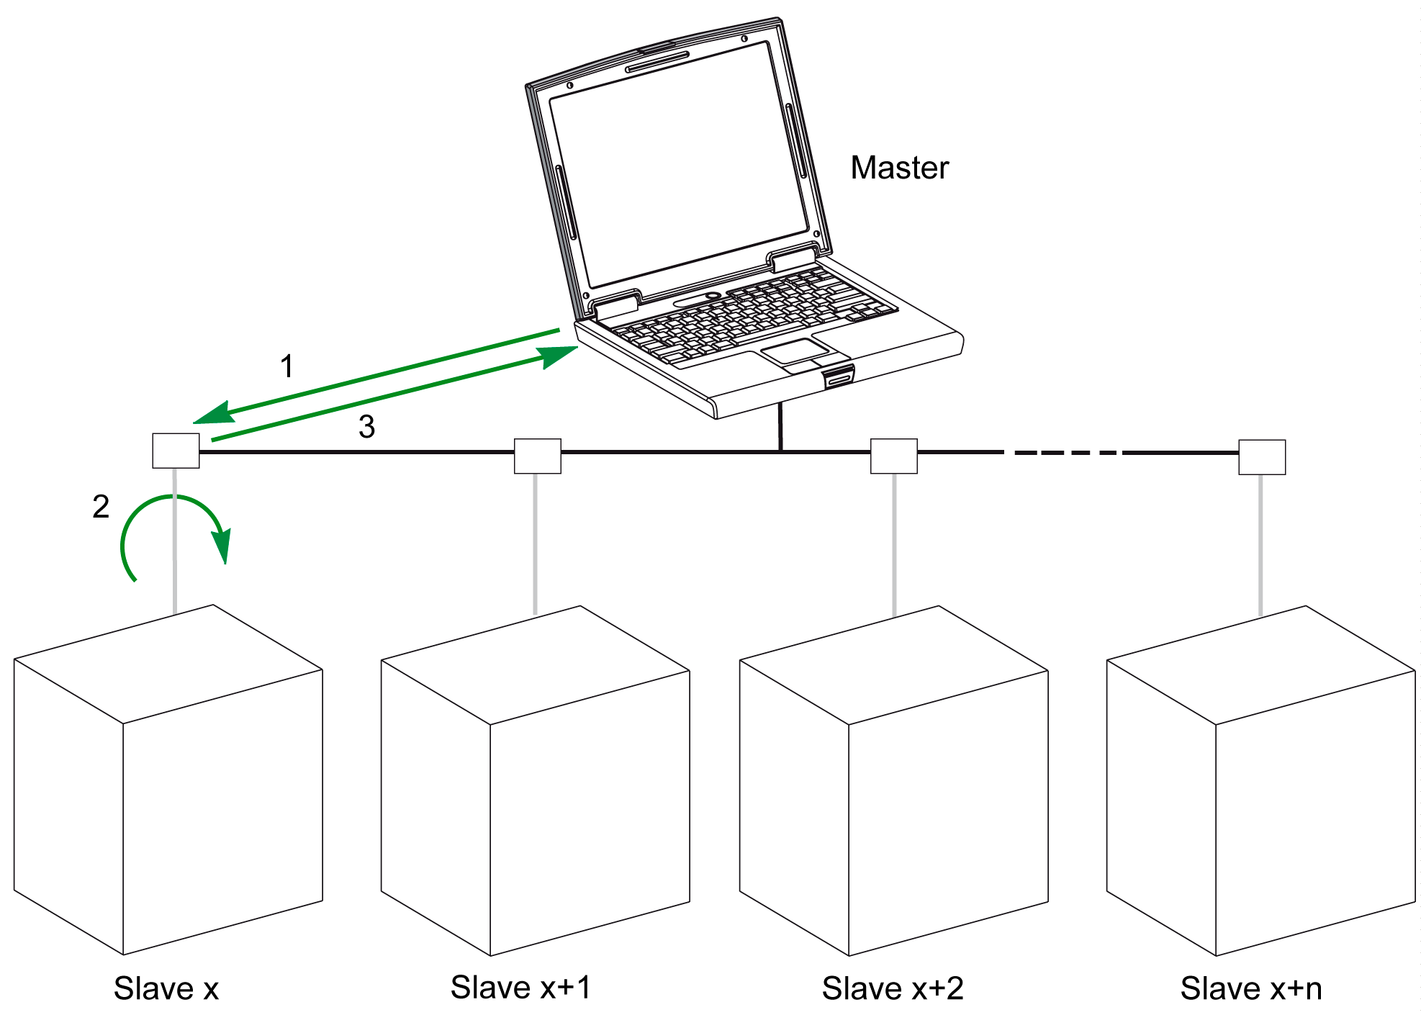
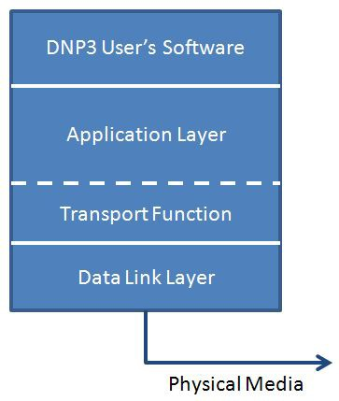
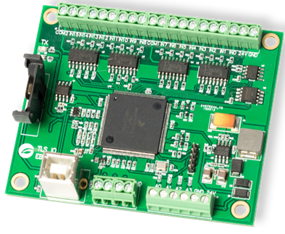
Adapting SCADA for IP
An insight into DNP3：
DNP3 (Distributed Network Protocol 3) is based on a Master/Slave relationship
Master refers to a powerful computer located in the control center, e.g. a manager
Slave is a remote device with computing resources, e.g. sensors/actuators
DNP3 node over RS485

Slide 13
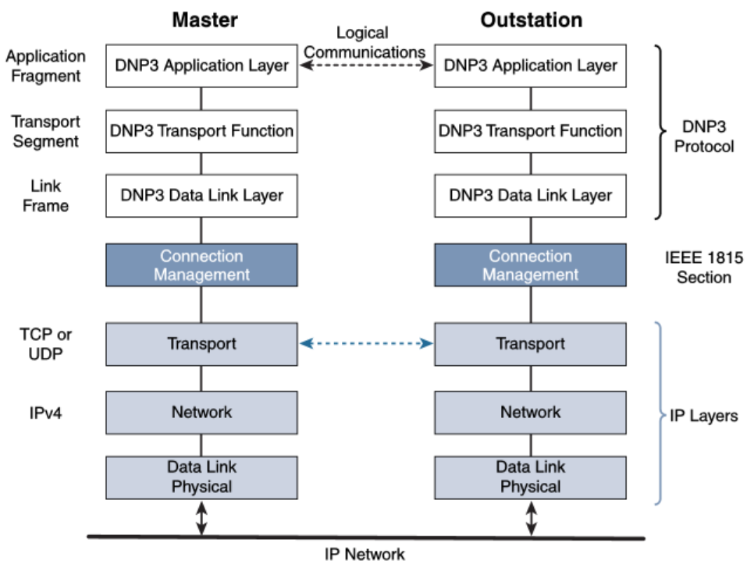
Adapting SCADA for IP
DNP3 over IP：
The IEEE 1815-2012 specification describes how the DNP3 must be adapted to run either over TCP (recommended) or UDP.
Connection management links the DNP3 layers with the IP layers

Slide 14
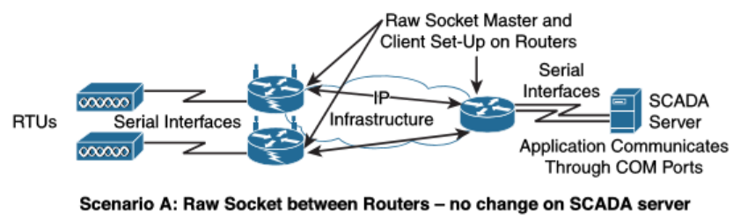
Tunneling Legacy SCADA over IP
End-to-end native IP support is preferred, like in the case of DNP3.
Otherwise, transport of the original serial protocol over IP can be achieved by tunneling or protocol translation.

Slide 15
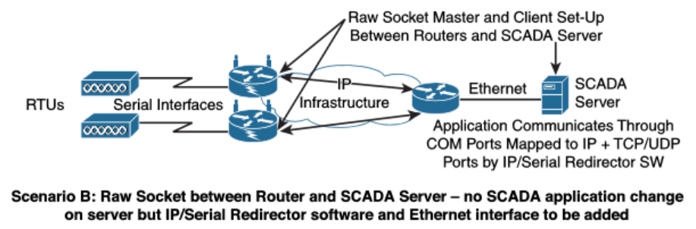
Tunneling Legacy SCADA over IP
End-to-end native IP support is preferred, like in the case of DNP3.
Otherwise, transport of the original serial protocol over IP can be achieved by tunneling or protocol translation.

Slide 16
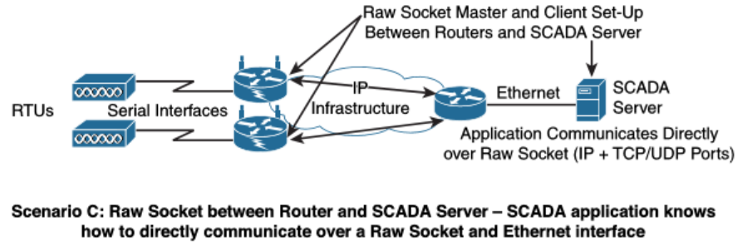
Tunneling Legacy SCADA over IP
End-to-end native IP support is preferred, like in the case of DNP3.
Otherwise, transport of the original serial protocol over IP can be achieved by tunneling or protocol translation.

Slide 17
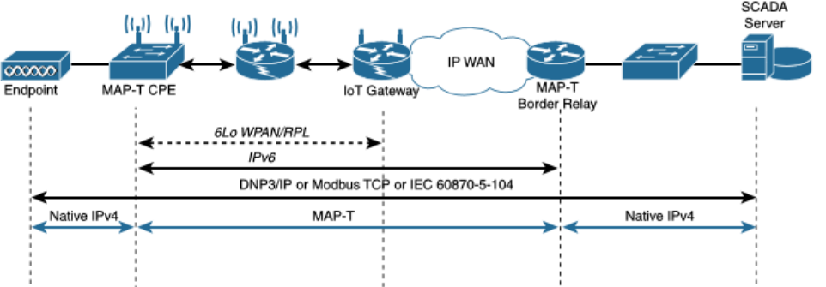
SCADA Transport over LLNs with MAP-T
Long-term evolution of SCADA or other industrial protocols is to natively support IPv6.
It must be highlighted that most of the industrial devices supporting IP today support IPv4 only.

Slide 18
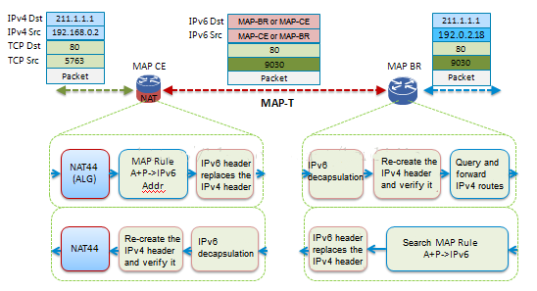
SCADA Transport over LLNs with MAP-T
On the sending side, IPv4 Address+port is mapped into an IPv6 header
On the receiving side, the IPv4 header is re-created
Source: huawei.com

Slide 19
Outlines
Transport Layer Protocols
Application layer protocol not present
Supervisory control and data acquisition (SCADA)
IoT application layer protocols
Constrained Application Protocol (CoAP)
Message Queuing Telemetry Transport (MQTT)

Slide 20
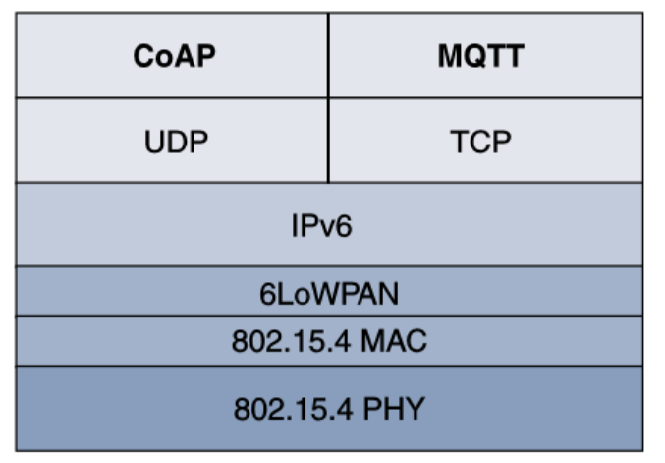
IoT Application Layer Protocols
When considering constrained networks and/or large-scale deployment of constrained nodes, the IoT industry is working on new lightweight protocols.
Constrained Application Protocol (CoAP) → over UDP
Message Queuing Telemetry Transport (MQTT) → over TCP

Slide 21
CoAP
CoAP resulted from the IETF Constrained RESTful (Representational State Transfer) Environments working group’s efforts.
RFC 6690: Constrained RESTful Environments (CoRE) Link Format
RFC 7252: The Constrained Application Protocol (CoAP)
RFC 7641: Observing Resources in CoAP
RFC 7959: Block-Wise Transfers in CoAP
RFC 8075: Guidelines for Mapping Implementations: HTTP to the (CoAP)
RFC 7252: securing CoAP with DTLS.

Slide 22
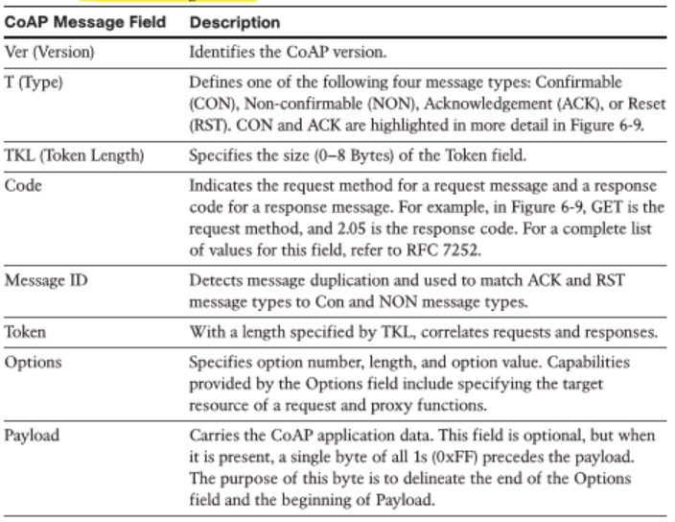
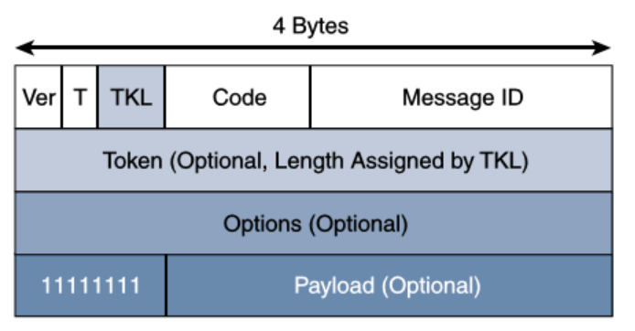
CoAP
CoAP has a fixed header length of 4 bytes

Slide 23
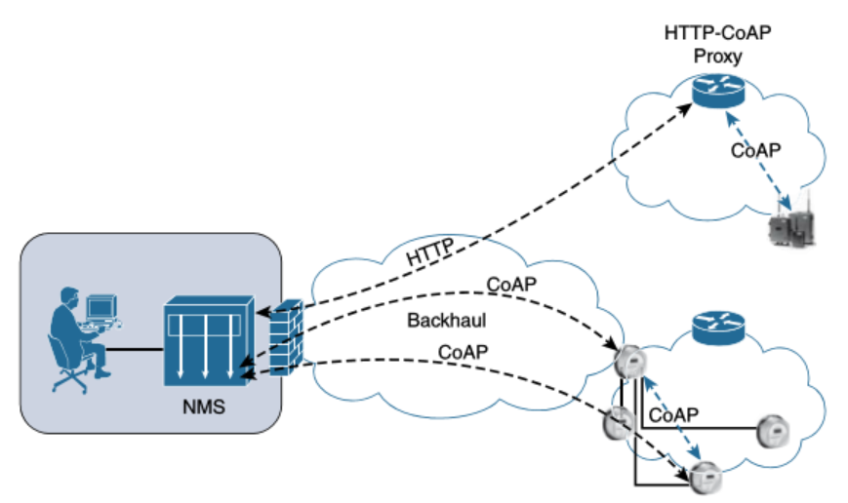
CoAP
Just like HTTP, CoAP is based on the REST architecture, but with a “thing” acting as both the client and the server.

Slide 24
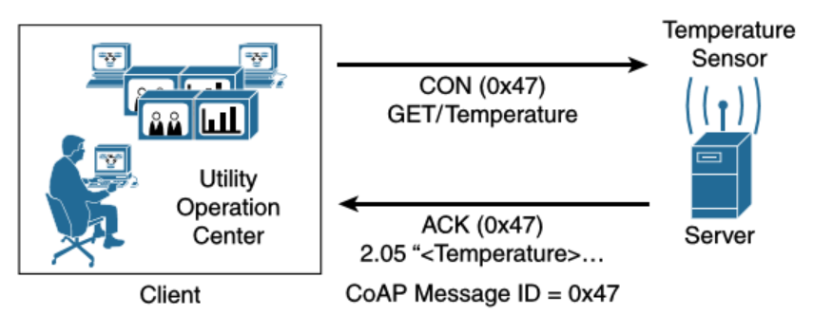
CoAP
Reliable transmission with CoAP
CoAP Reliable Transmission Example with confirmable message

Slide 25
Outlines
Transport Layer Protocols
Application layer protocol not present
Supervisory control and data acquisition (SCADA)
IoT application layer protocols
Constrained Application Protocol (CoAP)
Message Queuing Telemetry Transport (MQTT)

Slide 26
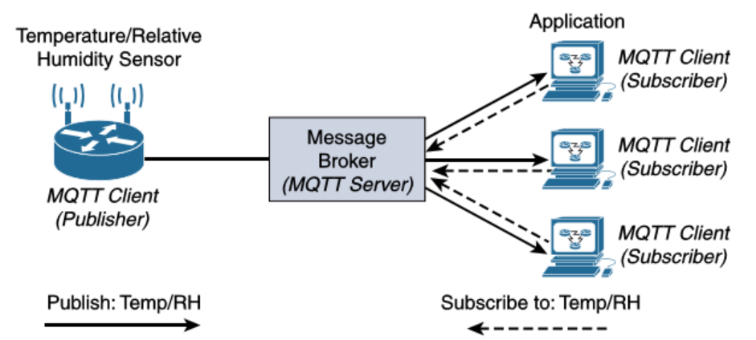
MQTT
A reliable, lightweight, and cost-effective protocol to monitor and control a large number of sensors → Message Queuing Telemetry Transport (MQTT)

Slide 27
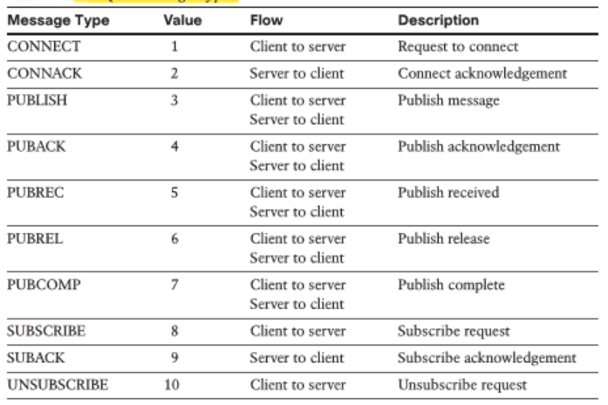
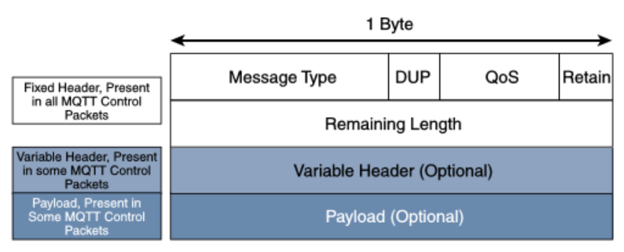
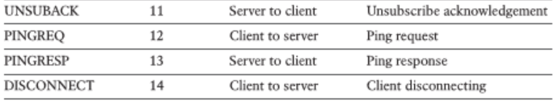
MQTT
MQTT is a lightweight protocol with each control packet consisting of a 2-byte fixed header
The first MQTT field in the header is Message Type, which identifies the kind of MQTT packet within a message.

Slide 28
MQTT
DUP (duplication flag) → to notate that the packet has been sent previously, but an acknowledgement was not received
QoS header field allows for the selection of three different QoS levels: 0, 1, 2
Retain flag→ notifies the server to hold onto the message data

Slide 29
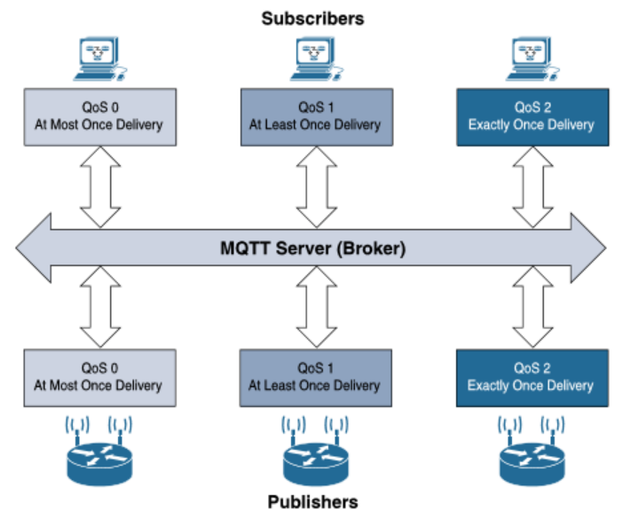
MQTT
QoS header field allows for the selection of three different QoS levels: 0, 1, 2

Slide 30
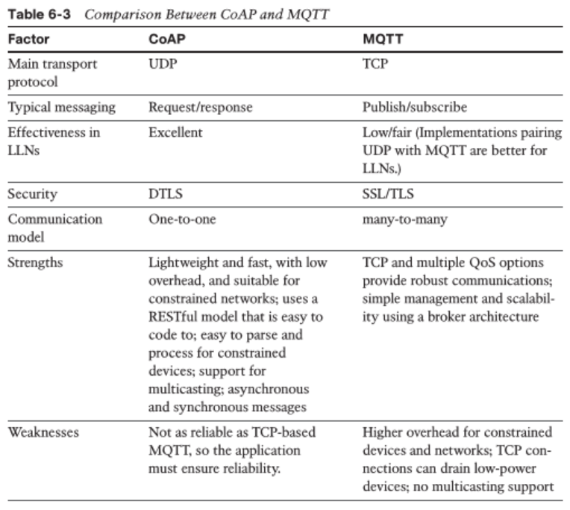
CoAP v.s. MQTT

Slide 31
Outlines
Transport Layer Protocols
Application layer protocol not present
Supervisory control and data acquisition (SCADA)
IoT application layer protocols
Constrained Application Protocol (CoAP)
Message Queuing Telemetry Transport (MQTT)

Slide 32
Thank you!
Q&A

